Slide 1
Summit for Early Childhood
Community College Faculty
SCRIPT-NC
October 1, 2014
10:00am – 4:00pm

Slide 2
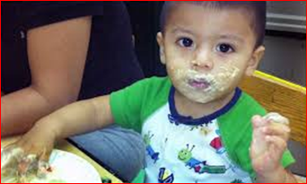
Welcome and Introductions
Name
Professional role and location
One strong belief about young children
SCRIPT-NC
Supporting Change and Reform in Preservice Teaching in North Carolina

Slide 3
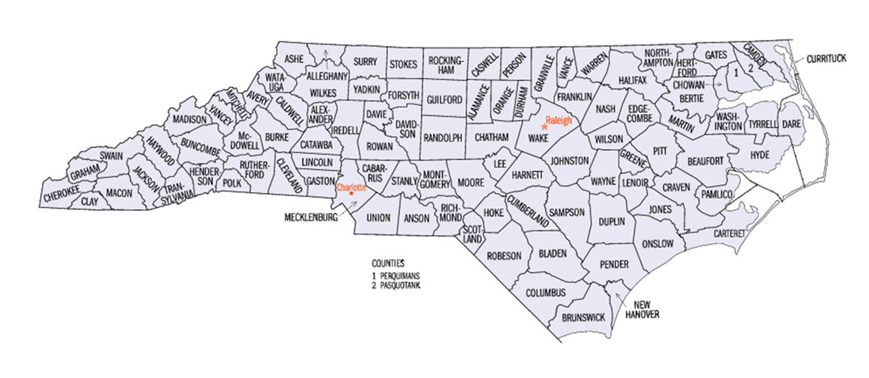
Overview of the Day
SCRIPT-NC
Supporting Change and Reform in Preservice Teaching in North Carolina

Slide 4
SCRIPT-NC Priorities
Supporting children who are culturally
and linguistically diverse
SCRIPT-NC
Supporting Change and Reform in Preservice Teaching in North Carolina

Slide 5
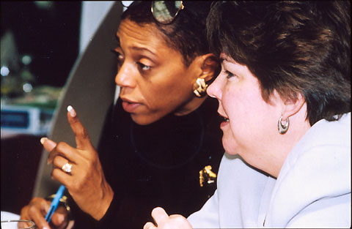
Objectives
Partner with community college faculty to identify, assess, and reconstruct key courses to incorporate research-based inclusion practices.

Slide 6
Partnerships
Vance-Granville Community College

Slide 7
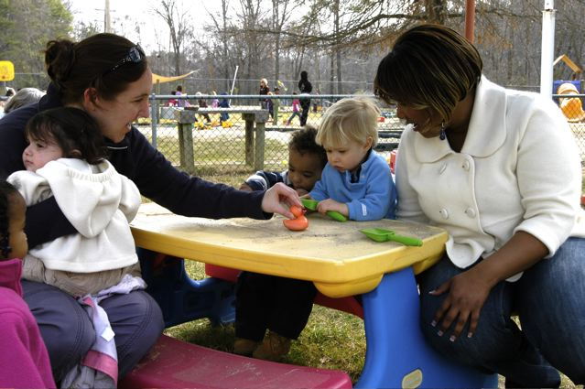
Objectives
Partner with community college faculty and supervising teachers to coordinate practica placements in high-poverty, inclusive settings.

Slide 8
Objectives
Provide ongoing professional development opportunities and supports for faculty.

Slide 9
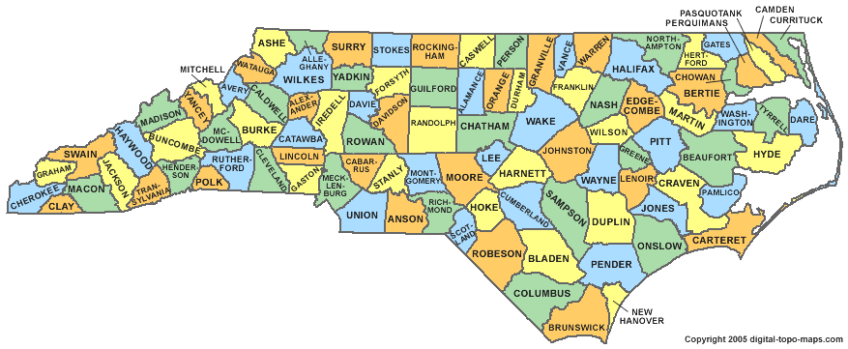
Objectives
Engage in statewide dissemination to support faculty and PD providers by providing resources to promote student use of evidence-based practices.

Slide 10
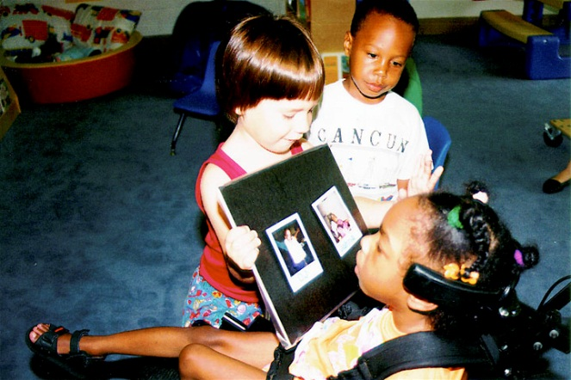
Essential Frameworks
Evidence-based practices
Inclusion
Culturally and linguistically responsive
approaches
Effective professional development

Slide 11
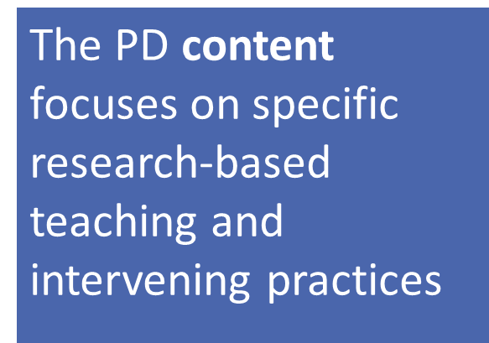
Essential Frameworks
Evidence-Based Practices
The delivery focuses on evidence-based methods for building practitioners’ knowledge and application of evidence-based practices

Slide 12
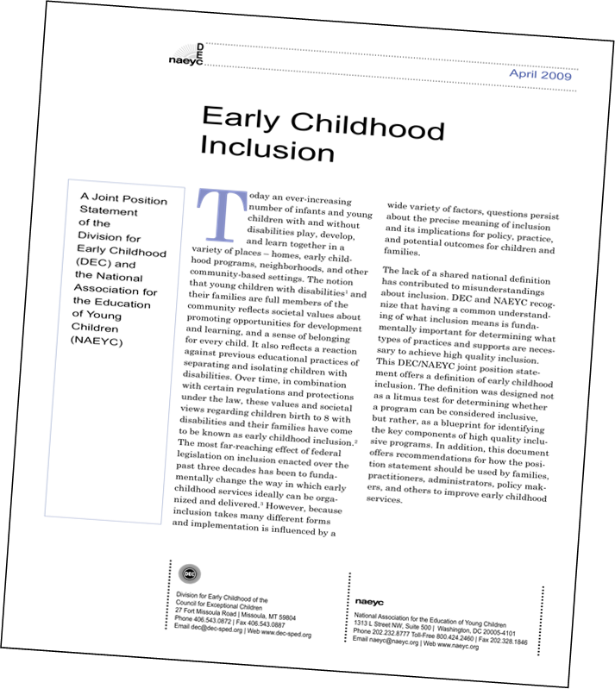
Essential Frameworks
Inclusion
Access
Participation
Supports

Slide 13
Access
SCRIPT-NC
Supporting Change and Reform in Preservice Teaching in North Carolina
Notes:
The first feature is access. Providing access to a wide range of learning opportunities, activities, settings, and environments is a defining feature of high quality inclusion in early childhood.

Slide 14
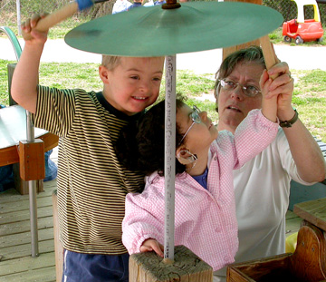
Participation
SCRIPT-NC
Supporting Change and Reform in Preservice Teaching in North Carolina
Notes:
The second feature is participation. Even if environments and programs are designed to facilitate access, some children may need additional individualized accommodations and supports to participate fully in early learning experiences. Adults promote belonging, participation, and engagement for children with and without disabilities in a variety of intentional ways. Not only do young children need supports; but in order for inclusion to be successful, there must be an infrastructure of supports for the adults who work with the children.

Slide 15
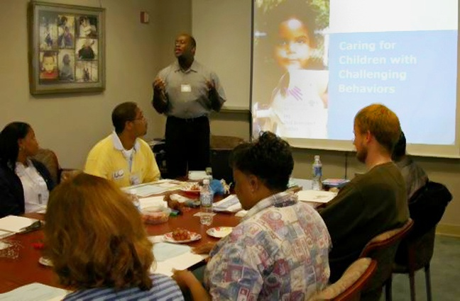
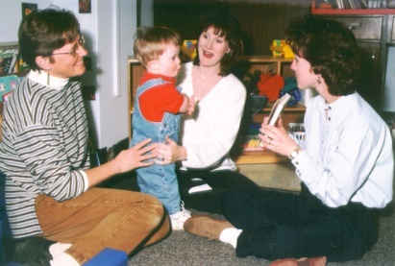
Supports
SCRIPT-NC
Supporting Change and Reform in Preservice Teaching in North Carolina
Notes:
The third defining feature is supports. In order for inclusion to work in community settings such as classrooms and homes, certain systems-level supports must be in place. These supports include:
professional development to ensure that practitioners and families have the knowledge, skills, and attitudes required to implement inclusive practices
resources and policies to promote opportunities for communication and collaboration among professionals and families
structures in place to help integrate and coordinate special services with general early childhood services and
standards that address program quality and professional competencies
So, you have heard the definition of inclusion. For more information contained in the position statement go to the link on the resources and references slide at the end of this presentation.

Slide 16
Essential Frameworks
Culturally and linguistically responsive approaches

Slide 17
NC Demographics (children under 6)
White 53%
Black/African-American 22%
Hispanic/Latino 17%

Slide 18
NC Demographics
In NC, 25% of young children live in poverty, defined as income below 100% of the federal poverty level.
Notes:
Source: Cardenas-Chiasson, A., Bruner, C., & Trefz, M. N. (2014). Fifty state chart book: Dimensions of diversity and the young child population. Des Moines, IA: Child and Family Policy Center. http://www.buildinitiative.org/Portals/0/Uploads/Documents/50StateChartBook-FinalDraft.pdf

Slide 19
NC needs early childhood professionals who . . .
Have high expectations for each child
Know how to connect with families who are culturally and linguistically diverse
Know about environments and interactions that support young learners who are diverse
Know how to use culturally and linguistically relevant, respectful and responsive practices
Notes:
Sources: National Urban Alliance. (2014). What we advocate. Retrieved from http://www.nuatc.org/our-work/what-we-advocate/; Derman-Sparks, L,. & Olsen Edwards, J. (2010). Anti-bias education for young children and ourselves. Washington, DC: NAEYC.

Slide 20
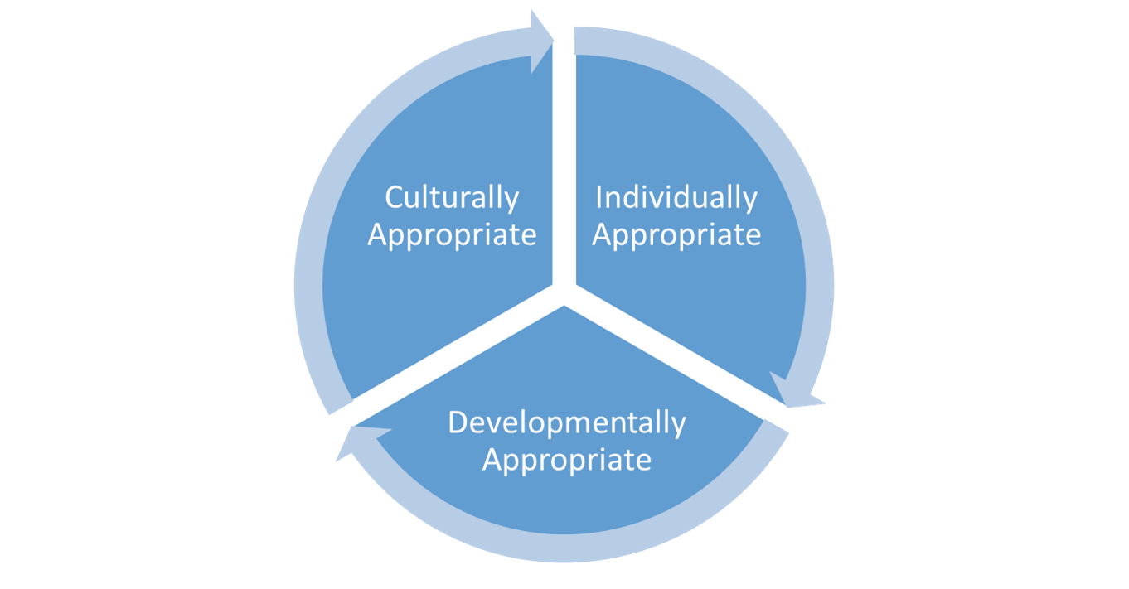
Do these frameworks sound familiar?

Slide 21
Knowledge
acquisition +
Knowledge application =
Effective professional development

Slide 22
What does this mean for you?

Slide 23
Today you’ll . . .
Clarify your values and vision
for your future graduates
Examine a course through some explicit and intentional lenses
Discover resources to support your work
Consider steps your program might take next
SCRIPT-NC
Supporting Change and Reform in Preservice Teaching in North Carolina

Slide 24
Our goal
This Not this
Notes:
Agenda/objectives
What’s in packet

Slide 25
Questions
SCRIPT-NC
Supporting Change and Reform in Preservice Teaching in North Carolina

Slide 26
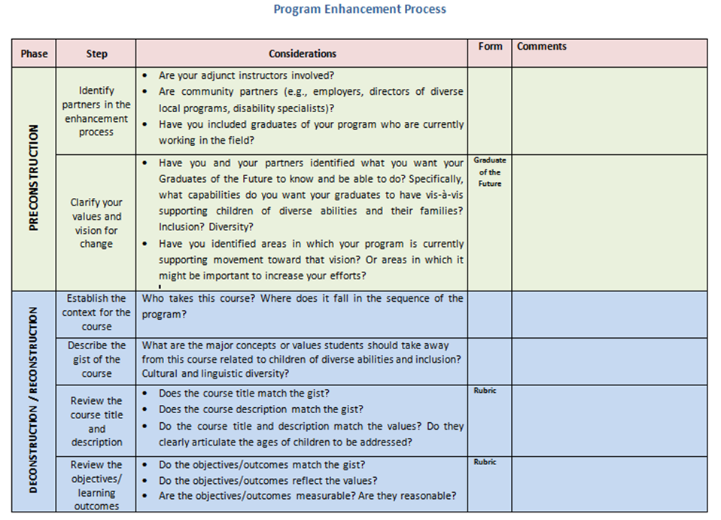
Program Enhancement Process

Slide 27
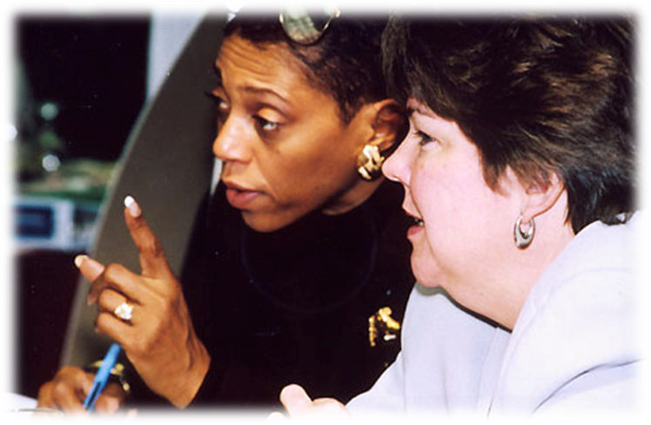
Preconstruction
Identify partners
Establish values and vision

Slide 28
Identifying Partners

Slide 29
Clarifying a Vision
Identify the knowledge, skills, and dispositions you want your graduates to have when they leave your program

Slide 30
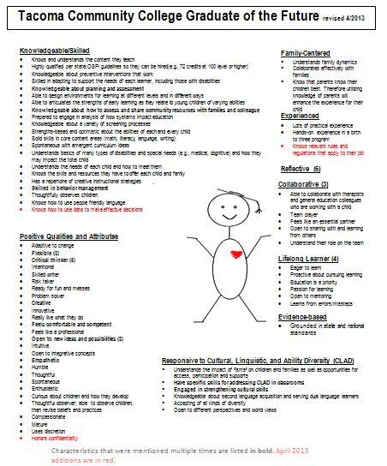
Graduate of the Future

Slide 31
Syllabus Deconstruction in Progress
SCRIPT-NC
Supporting Change and Reform in Preservice Teaching in North Carolina

Slide 32
Deconstructing/reconstructing courses
Overview of Course
Course Description
Student Learning Outcomes (SLOs)
Assignments
Required Materials/Texts
Course schedule/outline
 | Student Learning Outcomes
Assignment | 1 | 2 | 3 | 4 | 5 | 6
1-
2-
3-
4-

Slide 33
What’s the gist/context for this course?
Who takes the course?
Where does it fall in your sequence?
What are the major concepts you want students to take away?
What values do you want to underscore?

Slide 34
Non-negotiables
Course number and title
Course description
Student learning outcomes/objectives

Slide 35
Intentional Assignments
Make sure that every component of the course syllabus is aligned and consistent with goals and objectives of the course
Be specific about course assignments—make sure that they reflect the course goals and objectives
Instead of adding new goals and objectives to a course, embed EI/ECSE content into existing course components

Slide 36
Check your course assignments

Slide 37
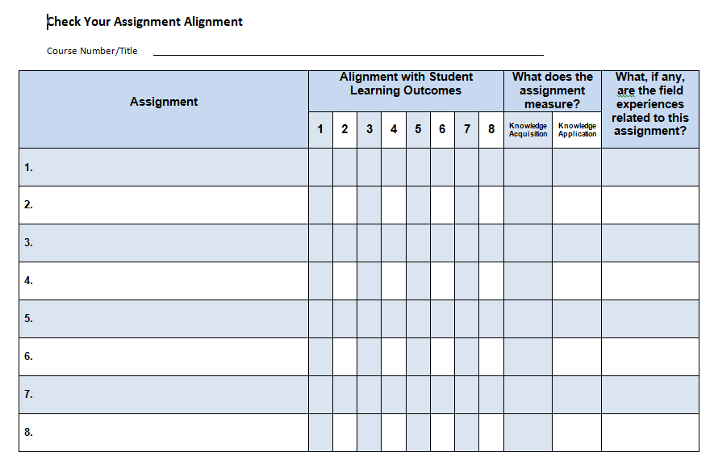
Check your assignment alignment

Slide 38
Questions
Comments
SCRIPT-NC
Supporting Change and Reform in Preservice Teaching in North Carolina

Slide 39
The wisdom of your peers
What has the process been like for your program?
What difference has it made for faculty? For students?
What advice would you give someone who is embarking on the program enhancement process?
November 6, 12:00 – 1:00
Topic: Creative Activities
SCRIPT-NC
Supporting Change and Reform in Preservice Teaching in North Carolina

Slide 40
Resources to support the process
Notes:
http://scriptnc.fpg.unc.edu/script-nc-nc-community-college-summit-october-1-2-2014

Slide 41
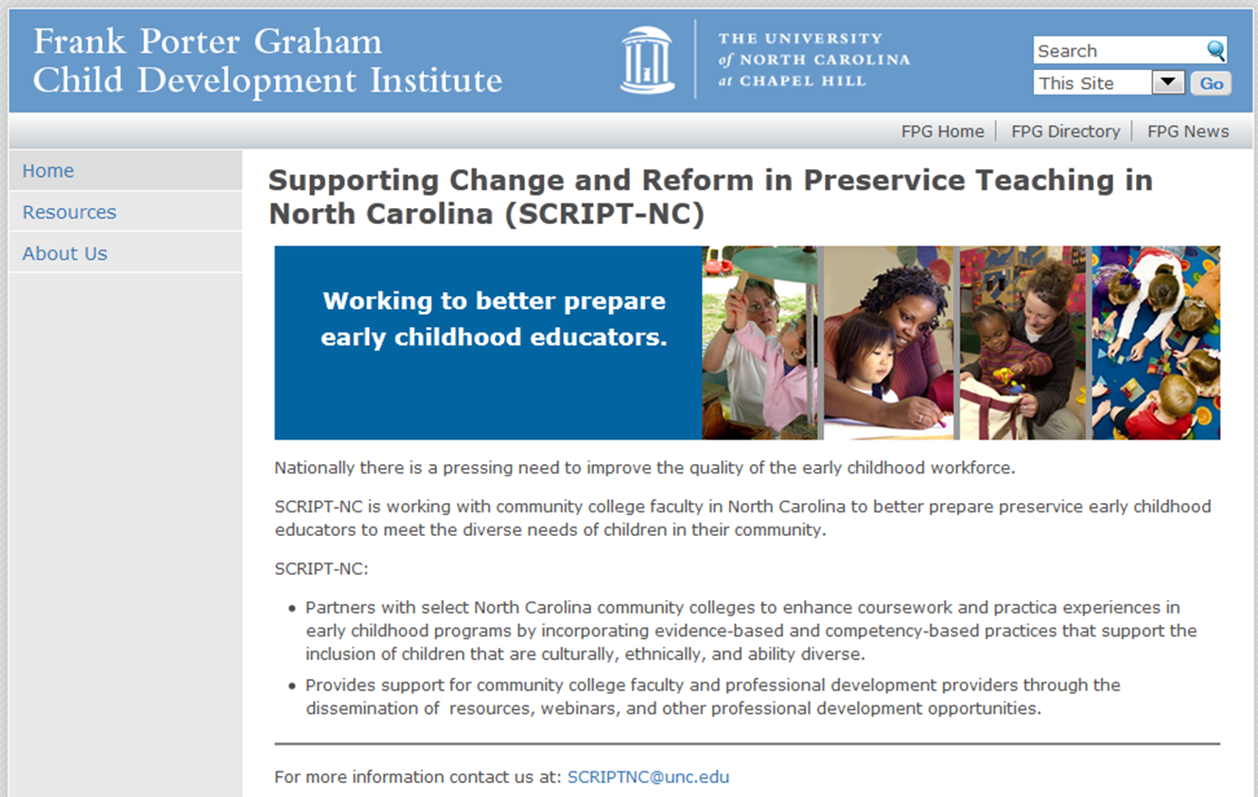
SCRIPT-NC http://scriptnc.fpg.unc.edu/

Slide 42
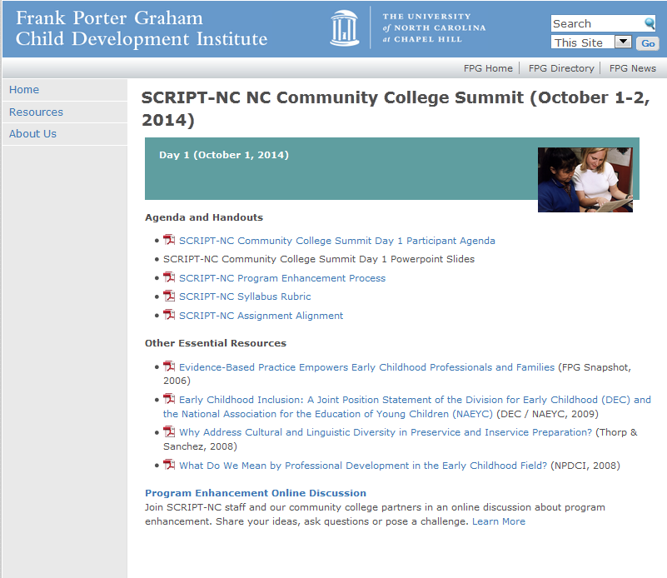
http://scriptnc.fpg.unc.edu/script-nc-nc-community-college-summit-october-1-2-2014

Slide 43
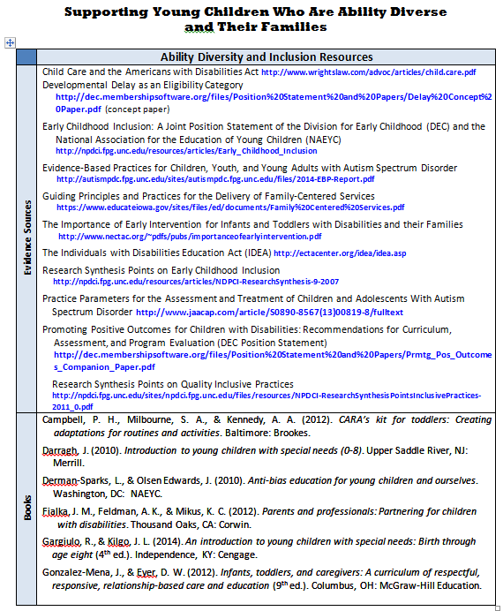
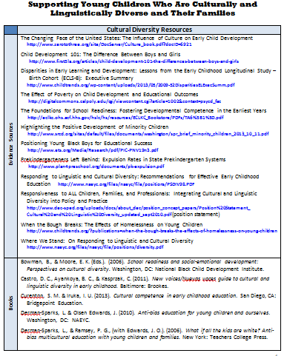
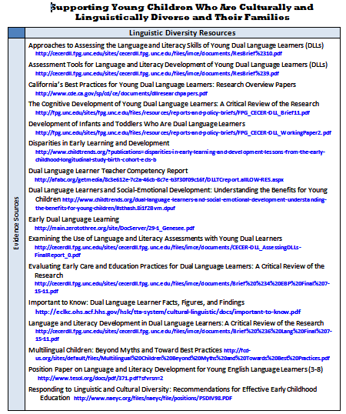
Three resource collections

Slide 44
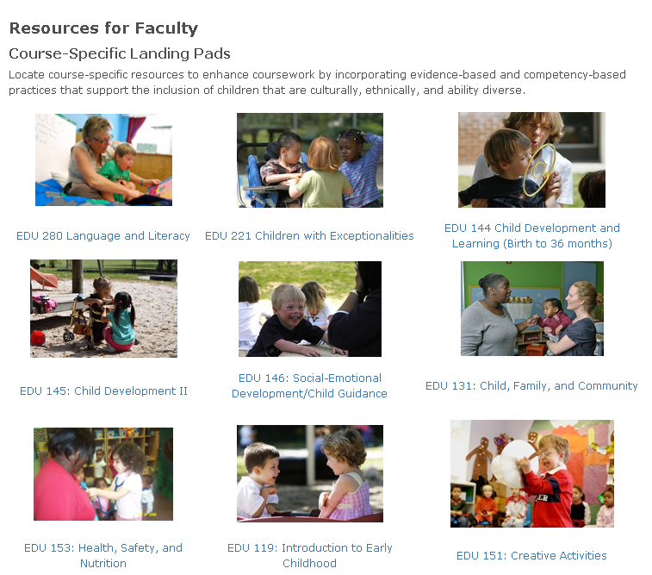
SCRIPT-NC
Supporting Change and Reform in Preservice Teaching in North Carolina
Landing
Pads
http://scriptnc.fpg.unc.edu/resource-search
SCRIPT-NC
Supporting Change and Reform in Preservice Teaching in North Carolina

Slide 45
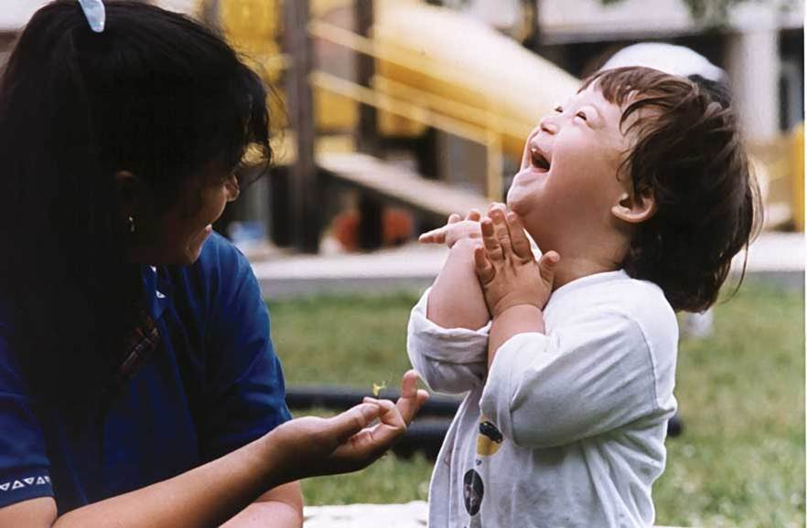
Upcoming Webinars (2014)
Co-sponsored by and
October 15, 2:00- 3:00 pm EST. Early Childhood Practicum
November 18, 2:00- 3:00 pm EST. Educational Technology
December 2, 2:00- 3:00 pm EST. Child Guidance (Note: Re-scheduled from May 15)
November 6, 12:00 – 1:00
Topic: Creative Activities
SCRIPT-NC
Supporting Change and Reform in Preservice Teaching in North Carolina

Slide 46
National Webinars (2015)
February 3, 2:00 – 3:00 pm EST Introduction to Early Childhood
March 3, 2:00 – 3:00 pm EST Infant/Toddler
April 7, 2:00 – 3:00 pm EST Child Development
May 5, 2:00 – 3:00 pm EST Child, Family and Community
June 2, 2:00 – 3:00 pm EST Child Guidance
July 7, 2:00- 3:00 pm EST Health, Safety, & Nutrition
August 4, 2:00- 3:00 pm EST Children with Exceptionalities
September 1, 2:00- 3:30 pm EST Language & Literacy Experiences
October 6, 2:00- 3:30 pm EST Creative Activities
November 3, 2:00- 3:00 pm EST Early Childhood Practicum
December 1, 2:00- 3:00 pm EST Educational Technology
November 6, 12:00 – 1:00
Topic: Creative Activities
SCRIPT-NC
Supporting Change and Reform in Preservice Teaching in North Carolina

Slide 47
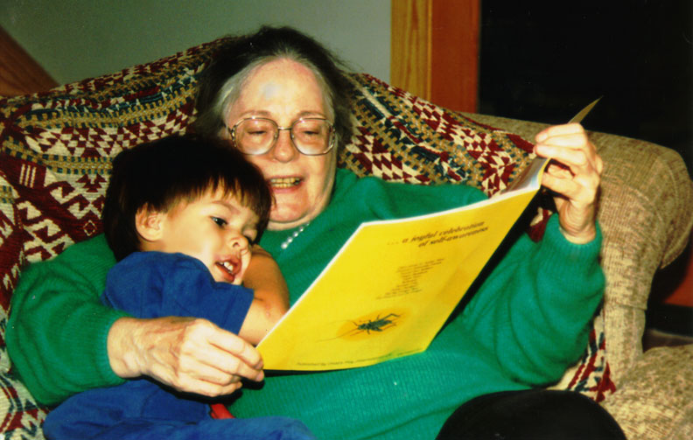
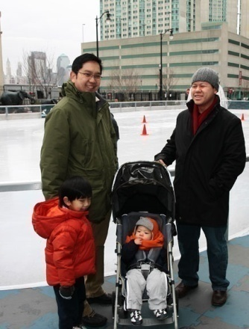
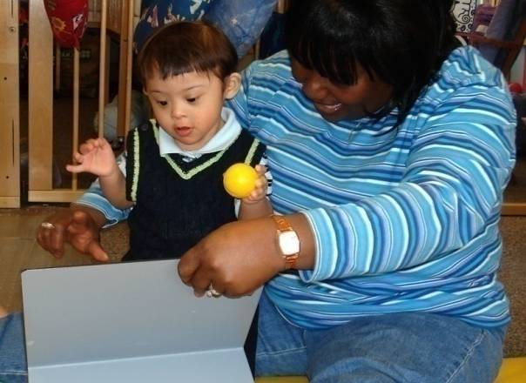
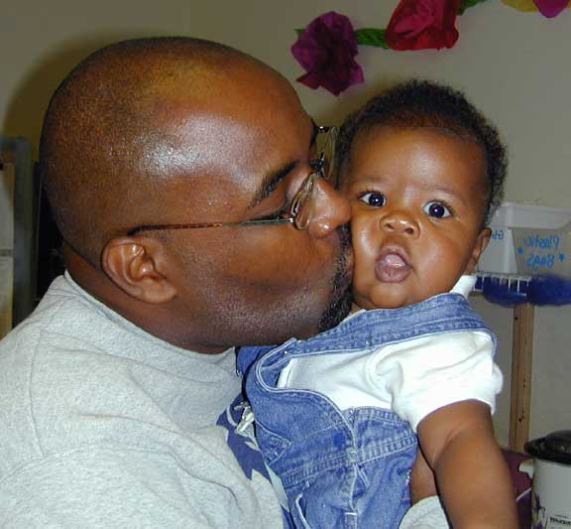
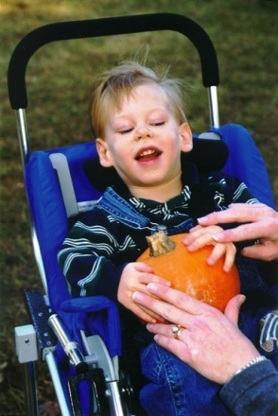
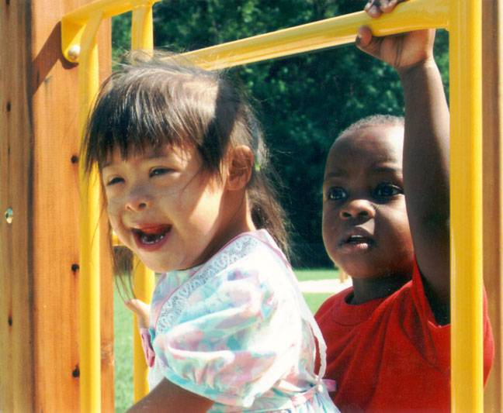
CONNECT
The Center to Mobilize Early Childhood Knowledge
http://connect.fpg.unc.edu/
Notes:
47

Slide 48
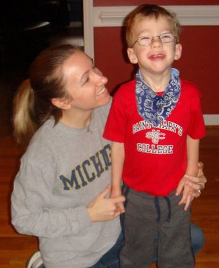
Available Modules
Module 3: Communication for Collaboration
Module 4: Family-Professional Partnerships
Module 1: Embedded Interventions
Module 2: Transition
Module 7: Tiered Instruction (Social emotional development & Academic learning)
Module 5: Assistive Technology Interventions
Module 6: Dialogic Reading

Slide 49
Questions
SCRIPT-NC
Supporting Change and Reform in Preservice Teaching in North Carolina

Slide 50
SCRIPT-NC supports for next steps
Option of follow-up conference call
Blog page for sharing/posting
Yearlong webinar series
November 6, 12:00 – 1:00
Topic: Creative Activities
SCRIPT-NC
Supporting Change and Reform in Preservice Teaching in North Carolina

Slide 52
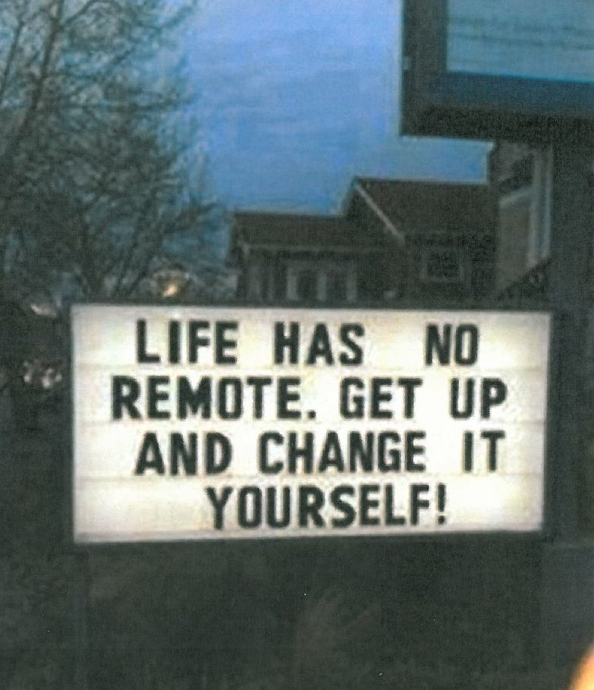
THANK YOU!
Please complete the evaluation and leave it on your table.
SCRIPT-NC
Supporting Change and Reform in Preservice Teaching in North Carolina
Notes:
52

