Slide 1
Infants, Toddlers, and TwosWebinar
April 7, 2015
2:00 pm – 3:00 pm EST
http://scriptnc.fpg.unc.edu

Slide 2
Welcome and Introductions

Slide 3
Features of SCRIPT-NC’s 2015 Webinar Series
Each webinar emphasizes | Each webinar features activities, assignments and strategies for incorporating
embedding inclusion and diversity into coursework resources, activities, and assignments for delivering course content to build both knowledge acquisition and knowledge application | state early learning guidelines the components of a formative assessment process 2014 DEC Recommended Practices
SCRIPT-NC
Supporting Change and Reform in Preservice Teaching in North Carolina

Slide 4
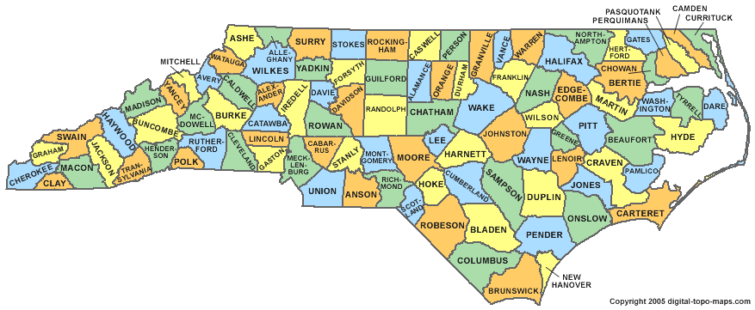
About SCRIPT-NC’s 2015 Webinar Series
Supports the Growing Greatness Curriculum Enhancement Process*
*Early Childhood Education Innovation Fund developed as part of NC’s Race to the Top and awarded through the NC Community College System
SCRIPT-NC
Supporting Change and Reform in Preservice Teaching in North Carolina

Slide 5
SCRIPT-NC
Supporting Change and Reform in Preservice Teaching in North Carolina
Landing
Pads
Handouts
PowerPoints
Recording
http://scriptnc.fpg.unc.edu/resource-search
SCRIPT-NC
Supporting Change and Reform in Preservice Teaching in North Carolina

Slide 6
Quick Poll
What is the outside temperature where you are?
SCRIPT-NC
Supporting Change and Reform in Preservice Teaching in North Carolina

Slide 7
Logistics
Questions? Comments?
USE THE CHAT BOX
SCRIPT-NC
Supporting Change and Reform in Preservice Teaching in North Carolina

Slide 8
http://scriptnc.fpg.unc.edu/resource-search
SCRIPT-NC
Supporting Change and Reform in Preservice Teaching in North Carolina

Slide 9
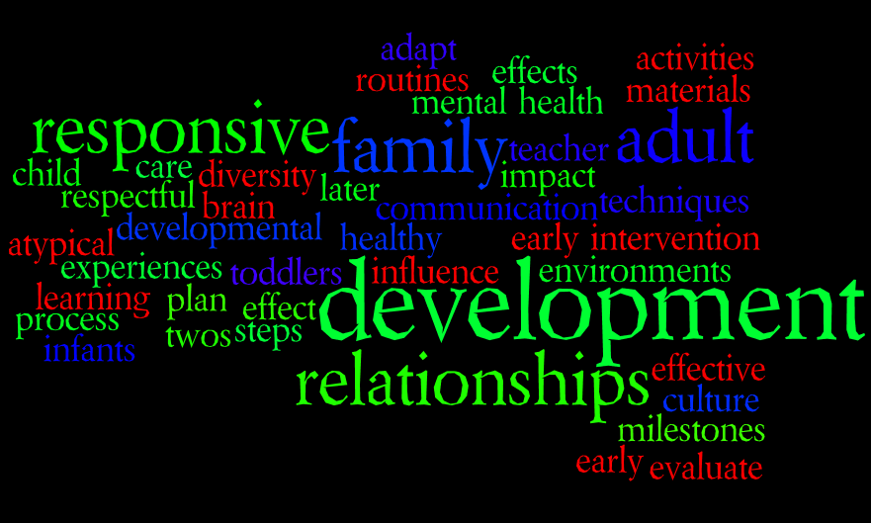
Common Areas of Emphasis
SCRIPT-NC
Supporting Change and Reform in Preservice Teaching in North Carolina

Slide 10
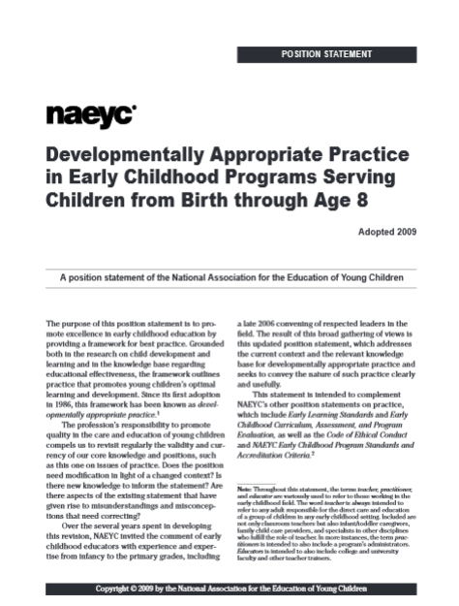
Developmental Contexts
Individually Appropriate
Developmentally Appropriate
Culturally
Appropriate
SCRIPT-NC
Supporting Change and Reform in Preservice Teaching in North Carolina

Slide 11
Commonly Used Commercial Resources
SCRIPT-NC
Supporting Change and Reform in Preservice Teaching in North Carolina

Slide 12
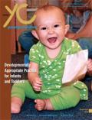
Look on your bookshelf
Developmentally Appropriate Practice for Infants & Toddlers
Articles, Reflections, Discussion Questions, Follow-Up Activities
Making the Right Choice Simple: Selecting Materials for Infants & Toddlers

Slide 13
Activities & Materials: Resources from NAEYC
Making the Right Choice Simple: Selecting Materials for Infants and Toddlers
Ani N. Shabazian & Carolina Li Soga
Young Children July 2014
Developmentally appropriate
Encourage participation
Open-ended
Healthy and safe
Neutral and nonbiased
Supportive of different domains
Spotlight on Young Children: Exploring Play (comprehensive NAEYC benefit)
Holly Bohart, Kathy Charner, & Derry Koralek
Let’s Get Messy! Learning Through Art and Sensory Play
12 articles organized by the age of the children
Questions and follow up activities for each article
SCRIPT-NC
Supporting Change and Reform in Preservice Teaching in North Carolina

Slide 14
Preparation to Observe
SCRIPT-NC
Supporting Change and Reform in Preservice Teaching in North Carolina

Slide 15
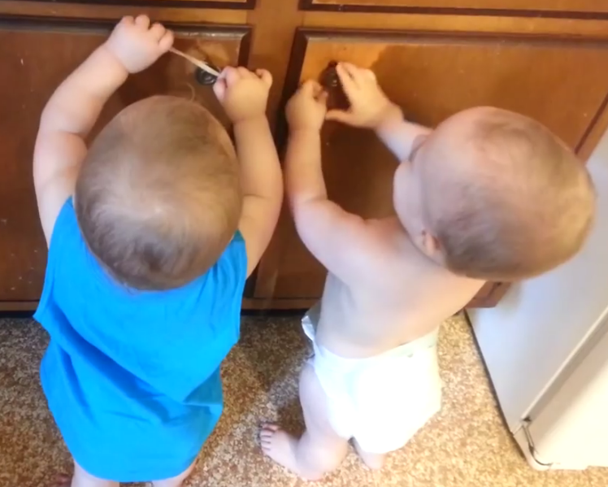
Rubber Band
Babies
SCRIPT-NC
Supporting Change and Reform in Preservice Teaching in North Carolina

Slide 16
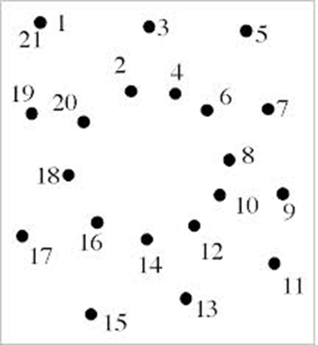
Help Your Students to Connect the Dots
Why do we observe?
Why do we document?
Observe how and how often?
Is it a difference? Or a delay?
The formative assessment process
Observe → document → monitor & evaluate progress → plan appropriate experiences
SCRIPT-NC
Supporting Change and Reform in Preservice Teaching in North Carolina

Slide 17
Emphasize Early Intervention
8 basic steps in the early intervention process
7 acronyms used in early intervention and what they mean
9 key terms in early intervention and their definitions
3 slideshow presentations
a Trainer’s Guide and Speaker’s Notes version of each slideshow
handouts and activity sheets
SCRIPT-NC
Supporting Change and Reform in Preservice Teaching in North Carolina

Slide 18
Early Intervention
Assignment
What agency is responsible for coordinating early intervention services in your state?
What is the definition for eligibility in your state?
What is the process for referring an infant or toddler for evaluation for early intervention services in your state?
Read about it
If I Could Rewind the Clock: I Wish I Would Have Known This About My Daughter’s Diagnosis
See/hear about it
Early Childhood Intervention: The Power of Family
SCRIPT-NC
Supporting Change and Reform in Preservice Teaching in North Carolina

Slide 19
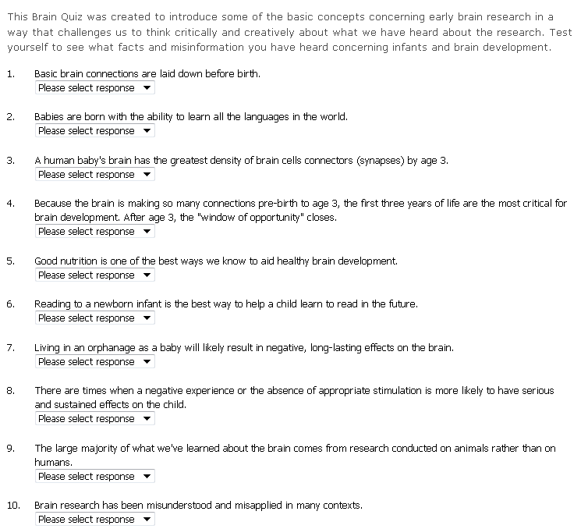
Brain Development
SCRIPT-NC
Supporting Change and Reform in Preservice Teaching in North Carolina

Slide 20
Respectful Relationships and Responsive Caregiving
Content
Vignettes
Reflection/Interview Questions
How does the physical environment support and encourage respectful relationships between early childhood professionals and children or between professionals and families?
Do you think early childhood professionals put too much pressure on families to share information about their lives? What do we really need to know?

Slide 21
Communication
Activity
Discuss the components of effective communication using Handout 3.1 - Communication Strategies to Build Collaboration from CONNECT Module 3
Give students a copy of the Communication Strategies Observation Checklist (Handout 3.2) from CONNECT Module 3
Show and discuss the three videos from CONNECT Module 3 (videos 3.3, 3.4, 4.5), which demonstrate key elements of effective communication.
Show other videos of family/teacher interactions (e.g., videos from CONNECT Module 4). Discuss the communication strategies that were demonstrated in each video, again using the Checklist.
SCRIPT-NC
Supporting Change and Reform in Preservice Teaching in North Carolina

Slide 22
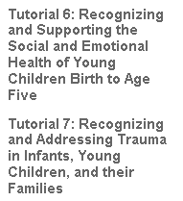
Mental Health
SCRIPT-NC
Supporting Change and Reform in Preservice Teaching in North Carolina

Slide 23
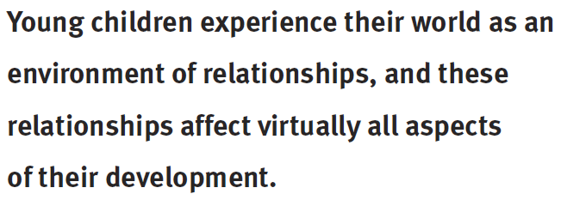
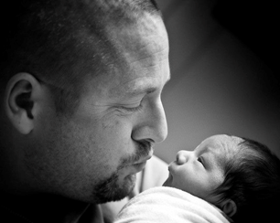
Environments
SCRIPT-NC
Supporting Change and Reform in Preservice Teaching in North Carolina

Slide 24
Environments
SCRIPT-NC
Supporting Change and Reform in Preservice Teaching in North Carolina

Slide 25
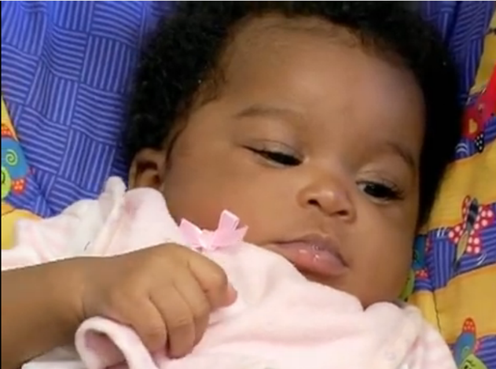
Interactions
Tronick’s Still Face Paradigm
SCRIPT-NC
Supporting Change and Reform in Preservice Teaching in North Carolina

Slide 26
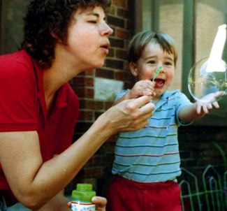
Our collective capability What’s your favorite resource (video, activity, reading, etc.) for your infant/toddler/twos course?
SCRIPT-NC
Supporting Change and Reform in Preservice Teaching in North Carolina

Slide 27
Activities
Develop observation and description skills
Support the use of Foundations (or other state early learning guidelines/standards) vis-à-vis recognizing developmental indicators
Support culturally and individually appropriate practices
Assignment
Imagine this: Mari, Ponijao, or Bayarjargal’s family is about to relocate to a program in your community in the US. If you were working as a teacher in that program (or a consultant to that program), what would you do to ensure that each child and family benefits from thoughtful, culturally-responsive services and supports?
SCRIPT-NC
Supporting Change and Reform in Preservice Teaching in North Carolina

Slide 28
Child Observation Assignment
Do you have an assignment like this?
Your assignment is to get to know an infant or toddler this semester. Select a child you do not know well so you can really practice your observations on them. You should observe the child at least twice a month, recording all observations. In your final paper, draw conclusions about how this child is doing developmentally.
SCRIPT-NC
Supporting Change and Reform in Preservice Teaching in North Carolina

Slide 29
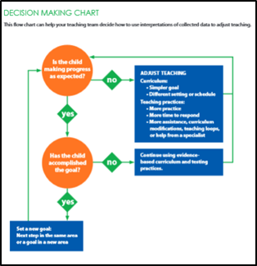
What about. . .
. . . incorporating an emphasis on formative assessment by introducing students to data-based decision making?
Require students to observe the same child at the same time of day over a period of several weeks
Require students to collect and graph data obtained from observation
Require students to make decisions about
next steps about how to/whether to adjust
teaching based on the data obtained
//studio.stupeflix.com/v/M8FHT7JW6u/?autoplay=1

Slide 30
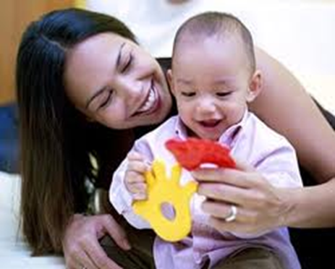
Or what about . . .
. . . looking at an infant/toddler setting through the lens of Universal Design for Learning (UDL)?
Ask students to read The Universal Design of Early Education: Moving Forward for All Children
Show students the Building Inclusive Childcare video
Introduce the UDL Checklist (Questions to Consider in UDL Observations in Early Childhood Environments)
Require students to use all or portions of the UDL checklist as a lens through which to observe
//studio.stupeflix.com/v/M8FHT7JW6u/?autoplay=1

Slide 31
Design an Infant/Toddler Classroom Assignment
Do you have an assignment like this?
Your assignment is to design a high-quality, developmentally appropriate indoor learning environment for an assigned infant, toddler, or twos group. You will create the floor plan, a materials list, and a PowerPoint that explains your vision of a high quality DAP environment.
SCRIPT-NC
Supporting Change and Reform in Preservice Teaching in North Carolina

Slide 32
What about. . .
. . . addressing components of this assignment across the semester?
Early in the semester, ask students to submit an initial design for a classroom.
Later mention that
several of the infants/toddlers/twos have home languages other than English
Several come from families with very few financial resources
One has an IFSP and is receiving speech therapy for significantly delayed speech and language.
Ask students to revise their original design (e.g., space for both small group and whole group work; images, labels, music that reflect the language/cultures of the families) to support these children.
OR, mention that the program will be adopting a Universal Design for Learning (UDL) approach to all classrooms. Ask students to revise their original design to support a UDL approach.
//studio.stupeflix.com/v/M8FHT7JW6u/?autoplay=1

Slide 33
Caregiver Handout Assignment
Create a simple handout that you could post in an infant, toddler, or two-year-old classroom listing at least ten suggestions the teachers or caregivers could use during caregiving routines to increase appropriate interactions and/or support the development of very young children.
SCRIPT-NC
Supporting Change and Reform in Preservice Teaching in North Carolina

Slide 34
What about. . .
. . . using this as an opportunity to learn more about how to support each infant/toddler/2?
Require suggestions that would support children who are dual language learners
Require suggestions that would support children who have a very brief attention span
Require suggestions that would support children who may have some developmental delays
Require adaptations for each suggestion that
would support different kinds of learners

Slide 35
What about. . .
. . . using this as an opportunity to learn more about evidence-based practices?
Consider asking teachers or caregivers about topics that they would like more information about (e.g., something that is an ongoing challenge in their classroom OR an area that they would like to learn more about)
Require to students to identify evidence-based approaches to addressing the challenge that has been identified.
Require students to present their ideas to the teachers/caregivers for feedback on the approaches identified.
OPTION: do the same with families (i.e., ask family members to identify a topic about which they would like more information)

Slide 36
Toy Design Assignment
Based on your readings, make a toy for an infant, toddler or two year old that addresses each of the domains of development.
SCRIPT-NC
Supporting Change and Reform in Preservice Teaching in North Carolina

Slide 37
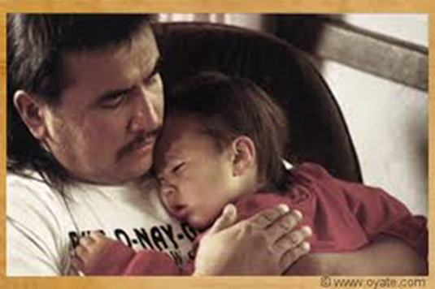
What about. . .
. . . revisiting this assignment?
Require students to use readily available, every day objects/materials to create the toy. Or require that the toy be created out of readily available natural materials.
Require students to address the developmental domains the toy could be used to address
Require students to create an activity sheet for families that will convey how they can make the toy and use it to support essential aspects of their child’s development.
//studio.stupeflix.com/v/M8FHT7JW6u/?autoplay=1

Slide 38
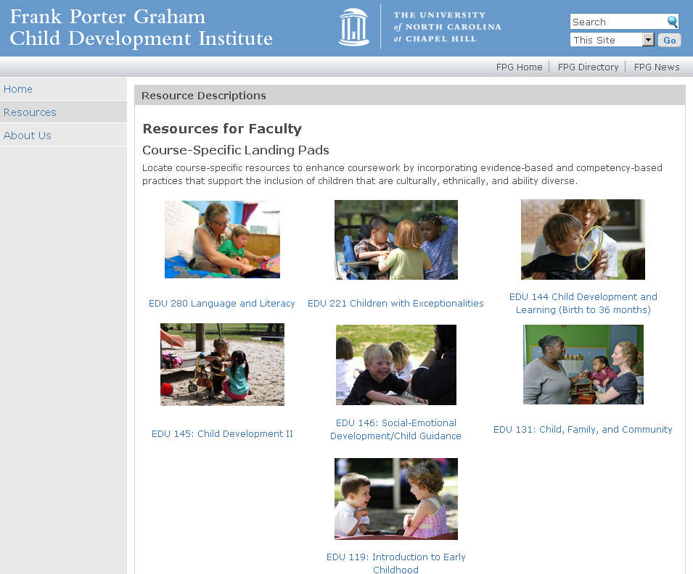
SCRIPT-NC
Supporting Change and Reform in Preservice Teaching in North Carolina
Landing
Pads
http://scriptnc.fpg.unc.edu/resource-search
SCRIPT-NC
Supporting Change and Reform in Preservice Teaching in North Carolina

Slide 39
Upcoming Webinar
May 5, 2015 2:00 pm – 3:00 pm EST
Topic: Child, Family, & Community
Register and check out the topics/dates for our 2015 webinar series:
https://unc.az1.qualtrics.com/SE/?SID=SV_4HhzfyxwEp2il25
November 6, 12:00 – 1:00
Topic: Creative Activities
SCRIPT-NC
Supporting Change and Reform in Preservice Teaching in North Carolina

Slide 40
Questions?
SCRIPT-NC
Supporting Change and Reform in Preservice Teaching in North Carolina

Slide 41
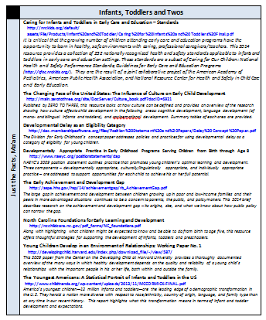
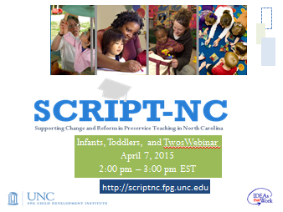
Next Steps
❶ Go to SCRIPT-NC
http://scriptnc.fpg.unc.edu/resource-search
❷ Click on Infants, Toddlers and Twos
❸ Access all the resources from
today’s webinar
SCRIPT-NC
Supporting Change and Reform in Preservice Teaching in North Carolina

Slide 42
SCRIPT-NC
Supporting Change and Reform in Preservice Teaching in North Carolina

Slide 43
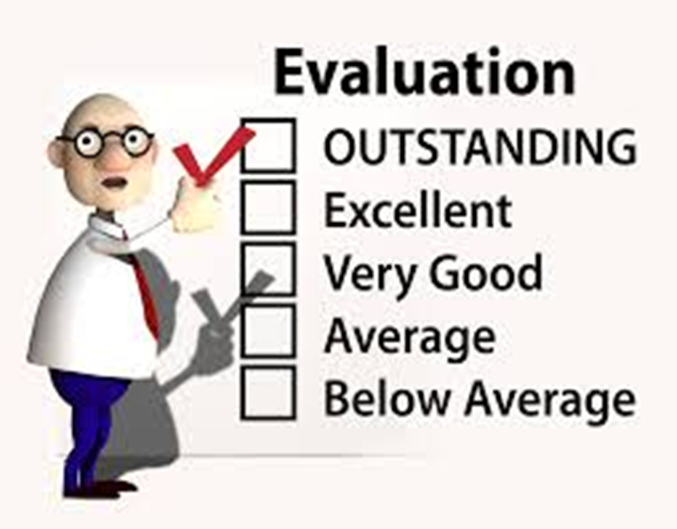
Give Us Your Feedback
SCRIPT-NC
Supporting Change and Reform in Preservice Teaching in North Carolina

Slide 44
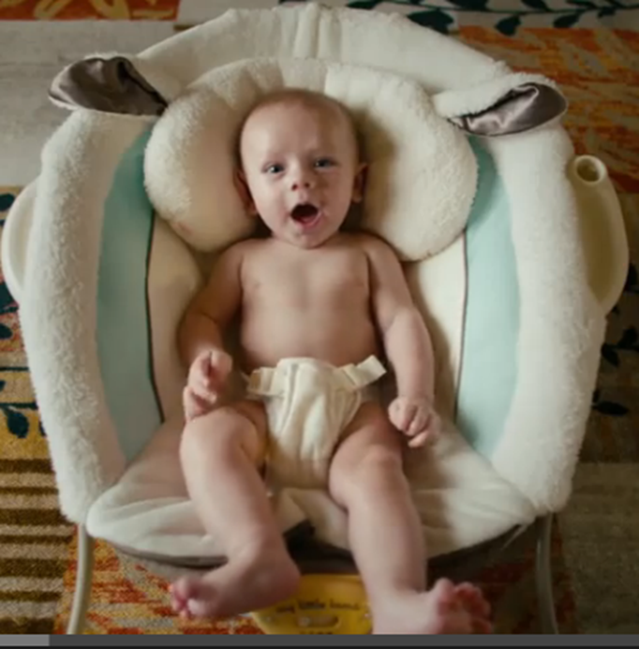
A final thought
https://www.youtube.com/watch?v=foc0WiujVKk

